Slide 1
Chef Fundamentals
An Introduction to the ChefDK

Slide 2
Ricardo Lupo
Solution Architect - Chef
Bryan Johnson
Solution Engineer- Chef
Michael Ducy
Global Partner Evangelist - Chef

Slide 3
Agenda

Slide 4
Our Expectations
You will leave this workshop with a basic understanding Chef's core components and ensure you have a workstation with all necessary tools installed.

Slide 5
A Taste of Chef
Chef is a large set of tools that are able to be used on multiple platforms and in numerous configurations. We will have time to only explore some of its most fundamental pieces.

Slide 6
Learning the Language
Learning Chef is like learning a language. You will reach fluency very fast but it will take practice until you become comfortable.
To best way to learn Chef is to use Chef.

Slide 7
Your Infrastructure
You bring with you your own domain expertise and problems. Chef is a framework for solving those problems. Our job is to teach you how to express solutions to your problems with Chef.

Slide 8
Ask Me Anything (AMA)
All of us are coming here with unique experiences and from unique teams that are using Chef in unique ways. It is important that we answer your questions and set you on the path to find more.

Slide 9
Getting a Workstation

Slide 10
Using a Cloud Workstation
To ensure the "smoothest" setup experience we will be using a virtual machine with all the necessary tools installed.

Slide 11
What About My Workstation?
At the end of the workshop we will have an InstallFest!
During that time we will install all the necessary tools on your workstation and troubleshoot any installation issues you may experience.

Slide 12
Getting Your Workstation
"Let's all hope the WiFi holds up to the onslaught."
– Conference Attendee
Raise your hand if you were not given an IP Address to login to

Slide 13
Resources
Chef's Fundamental Building Blocks

Slide 14
Welcome Email!
… listen, really sorry I didn't get a chance to finish setting up your workstation. There was another outage this morning!
Hey, also it would be awesome if you could test a config management tool to make it easier for the next few hires. Try chef-apply when you log in …

Slide 15
How about an $EDITOR?
Did she install anything another than some Chef tools? Is that all I'll need?
Install a command-line text editor (i.e. emacs, nano, vim).
Pick an editor
Install the editor through chef-apply

Slide 16
Choose an Editor
Emacs
Nano
Vim

Slide 17
EMACS
OPEN FILE
WRITE FILE
EXIT
$ emacs FILENAME
ctrl+x, ctrl+w
ctrl+x, ctrl+c

Slide 18
NANO
OPEN FILE
WRITE (WHEN EXITING)
EXIT
$ nano FILENAME
ctrl+x, y, ENTER
ctrl+x

Slide 19
VIM
OPEN FILE
START EDITING
WRITE FILE
EXIT
EXIT (don't write)
$ vim FILENAME
i
ESC, :w
ESC, :q
ESC, :q!

Slide 20
How about nano?
$ which nano
/usr/bin/which: no nano in (/usr/local/sbin:/usr/local/bin:/sbin:/bin:/usr/sbin:/usr/bin:/root/bin)

Slide 21
How about vim?
$ which vim
/usr/bin/which: no vim in (/usr/local/sbin:/usr/local/bin:/sbin:/bin:/usr/sbin:/usr/bin:/root/bin)

Slide 22
How about emacs?
$ which emacs
/usr/bin/which: no emacs in (/usr/local/sbin:/usr/local/bin:/sbin:/bin:/usr/sbin:/usr/bin:/root/bin)

Slide 23
Learning Chef
The best way to learn Chef is to use Chef.

Slide 24
What is chef-apply?
An executable program that allows you to work with resources and recipe files.

Slide 25
What can chef-apply do?
$ sudo chef-apply --help
Usage: chef-apply [RECIPE_FILE] [-e RECIPE_TEXT] [-s]
--[no-]color Use colored output, defaults to enabled
-e, --execute RECIPE_TEXT Execute resources supplied in a string
-l, --log_level LEVEL Set the log level (debug, info, warn, error, fatal)
-s, --stdin Execute resources read from STDIN
-v, --version Show chef version
-W, --why-run Enable whyrun mode
-h, --help Show this message

Slide 26
Resources
A resource is a statement of configuration policy. It describes the desired state of an element of your infrastructure, along with the steps needed to bring that item to the desired state. Each resource statement includes the resource type (such as …
http://docs.chef.io/chef/resources.html

Slide 27
Example: Package
package "httpd"
The package named "httpd" is installed.
http://docs.chef.io/chef/resources.html#package

Slide 28
Example: Service
service "ntp" do
action [ :enable, :start ]
end
The service named "ntp" is enabled (start on reboot) and started.
http://docs.chef.io/chef/resources.html#service

Slide 29
Example: File
file "/etc/motd" do
content "This company is the property ..."
end
The file name "/etc/motd" is created with content "This company is the property ..."
http://docs.chef.io/chef/resources.html#file

Slide 30
Example: File
file "/etc/motd" do
action :delete
end
The file name "/etc/motd" is deleted.
http://docs.chef.io/chef/resources.html#file

Slide 31
Let's try out execute
$ sudo chef-apply --help
Usage: chef-apply [RECIPE_FILE] [-e RECIPE_TEXT] [-s]
--[no-]color Use colored output, defaults to enabled
-e, --execute RECIPE_TEXT Execute resources supplied in a string
-l, --log_level LEVEL Set the log level (debug, info, warn, error, fatal)
-s, --stdin Execute resources read from STDIN
-v, --version Show chef version
-W, --why-run Enable whyrun mode
-h, --help Show this message

Slide 32
Example: Installing nano
$ sudo chef-apply -e ”package 'nano’ "
Recipe: (chef-apply cookbook)::(chef-apply recipe)
* yum_package[nano] action install
- install version 2.0.9-7.el6 of package nano

Slide 33
Did I install nano?
$ which nano
/bin/nano

Slide 34
Test and Repair
What happens when I run the command again?

Slide 35
Test and Repair
What would happen if the package were to become uninstalled?

Slide 36
Test and Repair
chef-apply takes action only when it needs to. Think of it as test and repair. Chef looks at the current state of each resource and takes action only when that resource is out of policy.

Slide 37
package 'nano'
Is package named 'nano' installed?
(test)
Yes
No
Do Nothing
Bring resource to desired state
(repair)

Slide 38
Hello, World?
I heard Chef is written in Ruby. If that's the case its required that we write a quick "Hello, world!" application.
Create a recipe file that defines the policy:
The file named "hello.txt" is created with the content "Hello, world!".

Slide 39
Creating a recipe file named hello.rb
hello.rb
file "hello.txt" do
content "Hello, world!"
end
The file named "hello.txt" is created with the content "Hello, world!".
http://docs.chef.io/chef/resources.html#file

Slide 40
Can chef-apply run a recipe file?
$ sudo chef-apply --help
Usage: chef-apply [RECIPE_FILE] [-e RECIPE_TEXT] [-s]
--[no-]color Use colored output, defaults to enabled
-e, --execute RECIPE_TEXT Execute resources supplied in a string
-l, --log_level LEVEL Set the log level (debug, info, warn, error, fatal)
-s, --stdin Execute resources read from STDIN
-v, --version Show chef version
-W, --why-run Enable whyrun mode
-h, --help Show this message

Slide 41
Example: Applying a recipe file
$ sudo chef-apply hello.rb
Recipe: (chef-apply cookbook)::(chef-apply recipe)
* file[hello.txt] action create
- create new file hello.txt
- update content in file hello.txt from none to 315f5b
--- hello.txt 2015-02-07 04:12:56.303999953 -0500
+++ ./.hello.txt20150207-7977-13mwgr5 2015-02-07 04:12:56.303999953 -0500
@@ -1 +1,2 @@
+Hello, world!

Slide 42
What does hello.txt say?
$ cat hello.txt
Hello, world!

Slide 43
Test and Repair
What happens when I run the command again?

Slide 44
Test and Repair
What happens when the file contents is modified?

Slide 45
Test and Repair
What happens when the file is removed?

Slide 46
Test and Repair
What happens when the file permissions (mode), owner, or group change?
Have we defined a policy for these attributes?

Slide 47
Resource Definition
file "hello.txt" do
source "Hello, world!"
end
The TYPE named NAME should be ACTION'd with ATTRIBUTES

Slide 48
Resource Definition
file "hello.txt" do
source "Hello, world!"
end
The TYPE named NAME should be ACTION'd with ATTRIBUTES

Slide 49
Resource Definition
file "hello.txt" do
source "Hello, world!"
end
The TYPE named NAME should be ACTION'd with ATTRIBUTES

Slide 50
Resource Definition
file "hello.txt" do
source "Hello, world!"
end
The TYPE named NAME should be ACTION'd with ATTRIBUTES

Slide 51
Resource Definition
file "hello.txt" do
source "Hello, world!"
end
?
The TYPE named NAME should be ACTION'd with ATTRIBUTES

Slide 52
The file resource
Read http://docs.chef.io/chef/resources.html#file
Discover the file resource's:
default action
default values for mode, owner, and group.
Update the file policy in "hello.rb" to:
The file named "hello.txt" should be created with the content "Hello, world!", mode "0644", owner is "root", and group is "root"

Slide 53
The updated file resource
hello.rb
file "hello.txt" do
content "Hello, world!"
mode "0644"
owner "root"
group "root"
end
The default action is to create (not necessary to define it).
The default mode is "0777".
The default owner is the current user (could change).
The default group is the POSIX group (if available).
+
+
+

Slide 54
Questions
What questions can we answer for you?

Slide 55
Workstation Setup
Alright, it seems like I could create a recipe file to setup this workstation.
Create a recipe file named "setup.rb" that defines the policy:
Installs the $EDITOR
Install the tree package
Setting up a customized Message of the Day (MOTD)

Slide 56
Installing our Editor
?
The package named "$EDITOR" is installed.
http://docs.chef.io/chef/resources.html#package

Slide 57
Installing the tree package
?
The package named tree is installed.
http://docs.chef.io/chef/resources.html#package

Slide 58
Setting up a customized MOTD
?
The file named "/etc/motd" is created with the content "Property of ...".
http://docs.chef.io/chef/resources.html#file

Slide 59
Workstation Setup
Create a recipe file named "setup.rb" that defines the policy:
The package named "$EDITOR" is installed.
The package named tree is installed.
The file named "/etc/motd" is created with the content "Property of ...".

Slide 60
Workstation setup recipe file
setup.rb
package "nano"
package "vim"
package "emacs"
package "tree"
file "/etc/motd" do
content "Property of ..."
mode "0644"
owner "root"
group "root"
end
The package named "$EDITOR" is installed.
The package named tree is installed.
The file named "/etc/motd" is created with the content "Property of ...".

Slide 61
Let's Talk About Resources
Capture your answers because we're going to talk about them as a group.

Slide 62
Resources
What is a resource?

Slide 63
Resources
How did the previous examples (i.e. package, service, file) describe the desired state of an element of our infrastructure?

Slide 64
Resources
What are some other possible examples of resources?

Slide 65
Resources
What does it mean for a resource to be a statement of configuration policy?

Slide 66
Discussion
What is a resource?
How did the previous examples (i.e. package, service, file) describe the desired state of an element of our infrastructure?
What are some other possible examples of resources?
What does it mean for a resource to be a statement of configuration policy?

Slide 67
Discussion
What questions can we answer for you?
chef-apply
Resources
Resource - default actions and default attributes
Test and Repair

Slide 68
Break

Slide 69
Cookbooks
Organizing our recipes

Slide 70
Great First Day!
… at stand up you mentioned your workstation recipe - could you do something like that for a web server?
Also, is there a way to package up recipes you create with a version number (and maybe a README)? I think chef is able to generate something called a cookbook. Also, you really should start thinking about some version control. Don't want to lose all our hard work AGAIN ...

Slide 71
Versioning?
She has a point. How are we going to manage this file when I start to use it on more workstations?
Use chef to generate a cookbook to store our setup recipe
Update our recipe to install git
Add the setup cookbook to version control

Slide 72
What is chef?
An executable program that allows you generate cookbooks and cookbook components.

Slide 73
What can chef do?
$ chef --help
Usage:
chef -h/--help
chef -v/--version
chef command [arguments...] [options...]
Available Commands:
exec Runs the command in context of the embedded ruby
gem Runs the `gem` command in context of the embedded ruby
generate Generate a new app, cookbook, or component
shell-init Initialize your shell to use ChefDK as your primary ruby
install Install cookbooks from a Policyfile and generate a locked cookbook set
update Updates a Policyfile.lock.json with latest run_list and cookbooks

Slide 74
Cookbooks
A cookbook is the fundamental unit of configuration and policy distribution. Each cookbook defines a scenario, such as everything needed to install and configure MySQL, and then it contains all of the components that are required to support that scenario . . .
http://docs.chef.io/cookbooks.html

Slide 75
What can chef generate do?
$ chef generate --help
Usage: chef generate GENERATOR [options]
Available generators:
app Generate an application repo
cookbook Generate a single cookbook
recipe Generate a new recipe
attribute Generate an attributes file
template Generate a file template
file Generate a cookbook file
lwrp Generate a lightweight resource/provider
repo Generate a Chef policy repository
policyfile Generate a Policyfile for use with the install/push commands (experimental)

Slide 76
What can chef generate cookbook do?
$ chef generate cookbook --help
Usage: chef generate cookbook NAME [options]
-C, --copyright COPYRIGHT Name of the copyright holder - defaults to 'The Authors'
-m, --email EMAIL Email address of the author - defaults to 'you@exa...
-a, --generator-arg KEY=VALUE Use to set arbitrary attribute KEY to VALUE in the...
-I, --license LICENSE all_rights, apache2, mit, gplv2, gplv3 - defaults ...
-g GENERATOR_COOKBOOK_PATH, Use GENERATOR_COOKBOOK_PATH for the code_generator...
--generator-cookbook

Slide 77
Lets create a cookbook!
$ chef generate cookbook setup
Compiling Cookbooks...
Recipe: code_generator::cookbook
* directory[/root/setup] action create
- create new directory /root/setup
* template[/root/setup/metadata.rb] action create_if_missing
- create new file /root/setup/metadata.rb
- update content in file /root/setup/metadata.rb from none to bd85d3
(diff output suppressed by config)
* template[/root/setup/README.md] action create_if_missing
- create new file /root/setup/README.md
- update content in file /root/setup/README.md from none to 44d165
(diff output suppressed by config)
* cookbook_file[/root/setup/chefignore] action create

Slide 78
The cookbook has a README
$ tree setup
setup
├── Berksfile
├── README.md
├── chefignore
├── metadata.rb
└── recipes
└── default.rb
1 directory, 5 files

Slide 79
README.md
The description of the cookbook's features written in Markdown.
http://daringfireball.net/projects/markdown/syntax

Slide 80
The cookbook has some metadata
$ tree setup
setup
├── Berksfile
├── README.md
├── chefignore
├── metadata.rb
└── recipes
└── default.rb
1 directory, 5 files

Slide 81
metadata.rb
Every cookbook requires a small amount of metadata. Metadata is stored in a file called metadata.rb that lives at the top of each cookbook’s directory.
http://docs.chef.io/config_rb_metadata.html

Slide 82
Lets take a look at the metadata
$ cat setup/metadata.rb
name 'setup'
maintainer 'The Authors'
maintainer_email 'you@example.com'
license 'all_rights'
description 'Installs/Configures setup'
long_description 'Installs/Configures setup'
version '0.1.0'

Slide 83
The cookbook has a folder for recipes
$ tree setup
setup
├── Berksfile
├── README.md
├── chefignore
├── metadata.rb
└── recipes
└── default.rb
1 directory, 5 files

Slide 84
The cookbook has a default recipe
$ cat setup/recipes/default.rb
# Cookbook Name:: setup
# Recipe:: default
#
# Copyright (c) 2015 The Authors, All Rights Reserved.

Slide 85
Copy the recipe into the cookbook
$ cp setup.rb setup/recipes/setup.rb

Slide 86
Version Control
Git is as good as any version control. Really anything is better than .bak!
Use chef to generate a cookbook to store our setup recipe
Update our recipe to install git
Add the setup cookbook to version control

Slide 87
Install git
Add the additional policy to the setup cookbook's setup recipe:
The package named "git" is installed.
Then apply this recipe with chef-apply

Slide 88
Adding the git package
setup/recipes/setup.rb
package "nano"
package "vim"
package "emacs"
package "tree"
package "git"
file "/etc/motd" do
content "Property of ..."
mode "0644"
owner "root"
group "root"
end
+

Slide 89
Re-apply the setup recipe
$ sudo chef-apply setup/recipes/setup.rb
Recipe: (chef-apply cookbook)::(chef-apply recipe)
* yum_package[git] action install
- install version 1.7.1-3.el6_4.1 of package git

Slide 90
chef-apply
chef-apply is a great tool for applying resources (-e) and for individual recipes but it does not know how to apply a cookbook. This is why we need to specify the path to the recipe file.
A better tool for applying cookbooks is called chef-client.

Slide 91
Version Control
This is a probably a good point to capture the initial state of our cookbook.
Use chef to generate a cookbook to store our setup recipe
Update our recipe to install git
Add the setup cookbook to version control

Slide 92
Move into the cookbook directory
$ cd setup

Slide 93
Initialize it as a git repository
$ git init
Initialized empty Git repository in /root/setup/.git/

Slide 94
Use git add to stage files to be committed.
$ git add .

Slide 95
Staging Area
The staging area is a file, generally contained in your Git directory, that stores information about what will go into your next commit. It’s sometimes referred to as the “index”, but it’s also common to refer to it as the staging area.
http://git-scm.com/book/en/v2/Getting-Started-Git-Basics

Slide 96
Use git status to view the staged files
$ git status
On branch master
#
# Initial commit
#
# Changes to be committed:
# (use "git rm --cached <file>..." to unstage)
#
# new file: .kitchen.yml
# new file: Berksfile
# new file: README.md
# new file: chefignore
# new file: metadata.rb
# new file: recipes/default.rb

Slide 97
Use git commit to save the staged changes
$ git commit -m "Initial setup cookbook"
Committer: root <root@fundamentals-3.0>
Your name and email address were configured automatically based
on your username and hostname. Please check that they are accurate.
You can suppress this message by setting them explicitly:
git config --global user.name "Your Name"
git config --global user.email you@example.com
If the identity used for this commit is wrong, you can fix it with:
git commit --amend --author='Your Name <you@example.com>'
11 files changed, 172 insertions(+), 0 deletions(-)

Slide 98
Version Control
Use "git init" inside the setup cookbook
Use "git add ." to stage all files to be committed
Use "git commit -m '...'" to save the staged changes

Slide 99
Move out of the setup cookbook
$ cd ~

Slide 100
Setting up a Web Server
Use chef generate to create a cookbook named "apache".
Write and apply a recipe named "apache.rb" with the policy:
The package named "httpd" is installed.
The file named "/var/www/html/index.html" is created with the content "<h1>Hello, world!</h1>"
The service named "httpd" is started.
The service named "httpd" is enabled.
Place the apache cookbook under version control

Slide 101
Lets create a cookbook!
$ chef generate cookbook apache
Compiling Cookbooks...
Recipe: code_generator::cookbook
* directory[/root/apache] action create
- create new directory /root/apache
* template[/root/apache/metadata.rb] action create_if_missing
- create new file /root/apache/metadata.rb
- update content in file /root/apache/metadata.rb from none to bd85d3
(diff output suppressed by config)
* template[/root/apache/README.md] action create_if_missing
- create new file /root/apache/README.md
- update content in file /root/apache/README.md from none to 44d165
(diff output suppressed by config)
* cookbook_file[/root/apache/chefignore] action create

Slide 102
Apache Recipe
apache/recipes/apache.rb
package "httpd"
file "/var/www/html/index.html" do
content "<h1>Hello, world!</h1>"
end
service "httpd" do
action [ :enable, :start ]
end

Slide 103
Apply the apache recipe
$ sudo chef-apply apache/recipes/apache.rb

Slide 104
Commit Your Work
$ cd apache
$ git init
$ git add .
$ git commit -m "Initial Apache Cookbook"

Slide 105
Discussion
What questions can we answer for you?
cookbooks
versions
version control

Slide 106
Break

Slide 107
chef-client
Applying recipes from cookbooks

Slide 108
chef-apply
chef-apply is a great tool for applying resources (-e) and for individual recipes but it does not know how to apply a cookbook. This is why we need to specify the path to the recipe file.
A better tool for applying cookbooks is called chef-client.

Slide 109
chef-client
A chef-client is an agent that runs locally on every node that is under management by Chef. When a chef-client is run, it will perform all of the steps that are required to bring the node into the expected state, including…
https://docs.chef.io/chef_client.html

Slide 110
Using chef-client to locally apply recipes
$ sudo chef-client --local-mode -r "recipe[setup::setup]"
Apply the following recipes locally:
The 'setup' recipe from the 'setup' cookbook

Slide 111
Using chef-client to locally apply recipes
$ sudo chef-client --local-mode -r "recipe[apache::apache]"
Apply the following recipes locally:
The 'apache' recipe from the 'apache' cookbook

Slide 112
Using chef-client to locally apply recipes
$ sudo chef-client --local-mode -r \ "recipe[setup::setup],recipe[apache::apache]"
Apply the following recipes locally:
The 'default' recipe from the 'setup' cookbook
The 'default' recipe from the 'apache' cookbook

Slide 113
--local-mode
chef-client's default mode attempts to contact a Chef Server and ask it for the recipes to run for the given node. We are overriding that behavior to have work in a local mode.

Slide 114
-r "recipe[COOKBOOK::RECIPE]"
In local mode we need to provide a list of recipes to apply to the system. This is called a run list. A run list is an ordered collection of recipes to execute.
Each recipe in the run list must be addressed with the format recipe[COOKBOOK::RECIPE].

Slide 115
Return home first
$ cd ~

Slide 116
Applying the apache::apache recipe locally
$ sudo chef-client --local-mode -r "recipe[apache::apache]"
[2015-03-29T21:38:56-07:00] WARN: No config file found or specified on command line, using command line options.
Starting Chef Client, version 11.16.4
resolving cookbooks for run list: ["apache::apache"]
================================================================================
Error Resolving Cookbooks for Run List:
================================================================================
Missing Cookbooks:

Slide 117
Create a cookbooks directory
$ mkdir cookbooks

Slide 118
Move the setup cookbook
$ mv setup cookbooks

Slide 119
Move the apache cookbook
$ mv apache cookbooks

Slide 120
Applying the apache::apache recipe locally
$ sudo chef-client --local-mode -r "recipe[apache::apache]"
[2015-03-29T21:38:08-07:00] WARN: No config file found or specified on command line, using command line options.
Starting Chef Client, version 11.16.4
resolving cookbooks for run list: ["apache::apache"]
Synchronizing Cookbooks:
- apache
Compiling Cookbooks...
Converging 3 resources
Recipe: apache::apache
...

Slide 121
Applying the setup::setup recipe locally
$ sudo chef-client --local-mode -r "recipe[setup::setup]"
[2015-03-29T21:38:08-07:00] WARN: No config file found or specified on command line, using command line options.
Starting Chef Client, version 11.16.4
resolving cookbooks for run list: ["setup::setup"]
Synchronizing Cookbooks:
- setup
Compiling Cookbooks...
Converging 6 resources
Recipe: setup::setup
...

Slide 122
Applying both recipes locally
$ sudo chef-client --local-mode \
-r "recipe[apache::apache], recipe[setup::setup]"
[2015-03-29T21:38:08-07:00] WARN: No config file found or specified on command line, using command line options.
Starting Chef Client, version 11.16.4
resolving cookbooks for run list: ["apache::apache", "setup::setup"]
Synchronizing Cookbooks:
- apache
- setup
Compiling Cookbooks...
Converging 9 resources
Recipe: apache::apache
...

Slide 123
-r "recipe[COOKBOOK(::default)]"
When you are referencing the default recipe within a cookbook you may optionally specify only the name of the cookbook. chef-client understands that you mean to apply the default recipe from within that cookbook.

Slide 124
Setting a default in our cookbook
It seems silly to type "recipe[setup::setup]". Typing out "recipe[setup]" also seems clearer.
Update the default recipe to use include_recipe to include the setup recipe.
Run chef-client and locally apply the run_list: "recipe[setup]"

Slide 125
include_recipe
A recipe can include one (or more) recipes located in cookbooks by using the include_recipe method. When a recipe is included, the resources found in that recipe will be inserted (in the same exact order) at the point where the include_recipe keyword is located.
https://docs.chef.io/recipes.html#include-recipes

Slide 126
Including a recipe
include_recipe "setup::setup"
Include the "setup" recipe from the "setup" cookbook in this recipe

Slide 127
Including a recipe
include_recipe "apache::apache"
Include the "apache" recipe from the "apache" cookbook in this recipe

Slide 128
The default recipe includes the setup recipe
cookbooks/setup/recipes/default.rb
#
# Cookbook Name:: setup
# Recipe:: default
#
# Copyright (c) 2015 The Authors, All Rights Reserved.
include_recipe "setup::setup"

Slide 129
Applying setup's default recipe
$ sudo chef-client --local-mode -r "recipe[setup]"
[2015-03-29T21:38:08-07:00] WARN: No config file found or specified on command line, using command line options.
Starting Chef Client, version 11.16.4
resolving cookbooks for run list: ["setup"]
Synchronizing Cookbooks:
- setup
Compiling Cookbooks...
Converging 6 resources
Recipe: setup::setup
...

Slide 130
Update the apache cookbook
Update the "apache" cookbook's "default" recipe to:
Include the "apache" recipe from the "apache" cookbook
Run chef-client and locally apply the run_list: "recipe[apache]"

Slide 131
The default recipe includes the apache recipe
cookbooks/apache/recipes/default.rb
#
# Cookbook Name:: apache
# Recipe:: default
#
# Copyright (c) 2015 The Authors, All Rights Reserved.
include_recipe "apache::apache"

Slide 132
Applying apache's default recipe
$ sudo chef-client --local-mode -r "recipe[apache]"
[2015-03-29T21:38:08-07:00] WARN: No config file found or specified on command line, using command line options.
Starting Chef Client, version 11.16.4
resolving cookbooks for run list: ["apache"]
Synchronizing Cookbooks:
- apache
Compiling Cookbooks...
Converging 3 resources
Recipe: apache::apache
...

Slide 133
Discussion
What questions can we help you answer?
chef-client
local mode
run list
include_recipe

Slide 134
Testing Cookbooks
Validating our recipes in virtual environments

Slide 135
Can We Test Cookbooks?
I'm going to miss our 1-on-1 this week because I was up way too late dealing with a deployment issue for that new event-queuing system. Apparently, no one had actually tested the deployment scripts on the actual platforms in production.
Jennifer and I did a quick post mortem and she mentioned that we can verify cookbooks with Test Kitchen and Docker. Is that something you could check out?

Slide 136
Test Configuration
What are we running in production? Maybe I could test the cookbook against a virtual machine.
Configure the "setup" cookbook's .kitchen.yml to use the Docker driver and CentOS 6.5 platform
Use kitchen converge to apply the recipe on a virtual machine

Slide 137
Test Kitchen
Test Kitchen is a test harness tool to execute your configured code on one or more platforms in isolation. A driver plugin architecture is used which lets you run your code on various cloud providers and virtualization technologies such as . . .
http://kitchen.ci

Slide 138
What can kitchen do?
$ kitchen --help
Commands:
kitchen console # Kitchen Console!
kitchen converge [INSTANCE|REGEXP|all] # Converge one or more instances
kitchen create [INSTANCE|REGEXP|all] # Create one or more instances
kitchen destroy [INSTANCE|REGEXP|all] # Destroy one or more instances
...
kitchen help [COMMAND] # Describe available commands or one specif...
kitchen init # Adds some configuration to your cookbook...
kitchen list [INSTANCE|REGEXP|all] # Lists one or more instances
kitchen setup [INSTANCE|REGEXP|all] # Setup one or more instances
kitchen test [INSTANCE|REGEXP|all] # Test one or more instances
kitchen verify [INSTANCE|REGEXP|all] # Verify one or more instances
kitchen version # Print Kitchen's version information

Slide 139
What can kitchen init do?
$ kitchen help init
Usage:
kitchen init
-D, [--driver=one two three] # One or more Kitchen Driver gems ...
# Default: kitchen-vagrant
-P, [--provisioner=PROVISIONER] # The default Kitchen Provisioner to use
# Default: chef_solo
[--create-gemfile], [--no-create-gemfile] # Whether or not to create a Gemfi ...
Description:
Init will add Test Kitchen support to an existing project for convergence
integration testing. A default .kitchen.yml file (which is intended to be
customized) is created in the project's root directory and one or more gems will be
added to the project's Gemfile.

Slide 140
Do we have a .kitchen.yml?
$ tree setup -a -I .git
setup
├── Berksfile
├── chefignore
├── .gitignore
├── .kitchen.yml
├── metadata.rb
├── README.md
├── recipes
│ ├── default.rb
│ └── setup.rb
├── spec
│ ├── spec_helper.rb
│ └── unit

Slide 141
What is inside.kitchen.yml?
$ cat setup/.kitchen.yml
---
driver:
name: vagrant
provisioner:
name: chef_solo
platforms:
- name: ubuntu-12.04
- name: centos-6.5
suites:
- name: default

Slide 142
.kitchen.yml
When chef generates a cookbook a default .kitchen.yml is created. It contains kitchen configuration for the driver, provisioner, platform, and suites.
http://kitchen.ci/docs/getting-started/creating-cookbook

Slide 143
The kitchen driver
setup/.kitchen.yml
---
driver:
name: vagrant
provisioner:
name: chef_zero
platforms:
- name: ubuntu-12.04
- name: centos-6.5
...
The driver is responsible for creating a machine that we'll use to test our cookbook.
Example Drivers:
docker
vagrant

Slide 144
The kitchen provisioner
setup/.kitchen.yml
---
driver:
name: vagrant
provisioner:
name: chef_zero
platforms:
- name: ubuntu-12.04
- name: centos-6.5
...
This tells Test Kitchen how to run Chef, to apply the code in our cookbook to the machine under test.
The default and simplest approach is to use chef_zero.

Slide 145
The kitchen platforms
setup/.kitchen.yml
---
driver:
name: vagrant
provisioner:
name: chef_zero
platforms:
- name: ubuntu-12.04
- name: centos-6.5
...
This is a list of operation systems on which we want to run our code.

Slide 146
The kitchen suites
setup/.kitchen.yml
suites:
- name: default
run_list:
- recipe[setup::default]
attributes:
This section defines what we want to test. It includes the Chef run-list and any node attribute setups that we want run on each platforms defined above.
We define a single suite named "default".

Slide 147
The kitchen suites
setup/.kitchen.yml
suites:
- name: default
run_list:
- recipe[setup::default]
attributes:
The suite named "default" defines a run_list.
Run the "setup" cookbook's "default" recipe file.

Slide 148
Kitchen Test Matrix
Kitchen defines a list of instances, or test matrix, based on the platforms multiplied by the suites.
PLATFORMS x SUITES
Running kitchen list will show that matrix.

Slide 149
View the Kitchen Test Matrix
$ kitchen list
Instance Driver Provisioner Last Action
default-ubuntu-1204 Vagrant ChefZero <Not Created>
default-centos-65 Vagrant ChefZero <Not Created>
suites:
- name: default
run_list:
- recipe[setup::default]
attributes:
platforms:
- name: ubuntu-12.04
- name: centos-6.4

Slide 150
View the Kitchen Test Matrix
$ kitchen list
Instance Driver Provisioner Last Action
default-ubuntu-1204 Vagrant ChefZero <Not Created>
default-centos-65 Vagrant ChefZero <Not Created>
suites:
- name: default
run_list:
- recipe[setup::default]
attributes:
platforms:
- name: ubuntu-12.04
- name: centos-6.4

Slide 151

Setting the driver to Docker
---
driver:
name: docker
provisioner:
name: chef_zero
platforms:
- name: centos-6.5
suites:
- name: default
run_list:
- recipe[setup::default]
attributes:
https://github.com/portertech/kitchen-docker

Slide 152

Setting the platform to CentOS 6.5
---
driver:
name: docker
provisioner:
name: chef_zero
platforms:
- name: centos-6.5
driver_config:
forward:
- 80:80
suites:
- name: default
run_list:
- recipe[setup::default]
attributes:
https://github.com/portertech/kitchen-docker

Slide 153
Update the .kitchen.yml
Update the "setup" cookbook's .kitchen.yml to use the docker driver and only the centos-6.5 platform.

Slide 154
Converging a Cookbook
Before I add features it really would be nice to test these cookbooks against the environments that resemble production.
Configure the "setup" cookbook's .kitchen.yml to use the Docker driver and CentOS 6.5 platform
Use kitchen converge to apply the recipe on a virtual machine

Slide 155
Kitchen Create
kitchen create
kitchen converge
kitchen verify
$ kitchen create [INSTANCE|REGEXP|all]
Create one or more instances.

Slide 156
Kitchen Converge
kitchen create
kitchen converge
kitchen verify
$ kitchen converge [INSTANCE|REGEXP|all]
Create the instance (if necessary) and then apply
the run list to one or more instances.

Slide 157
Converge the Recipe
We want to validate that our run-list installs correctly.
Within the "setup" cookbook use kitchen converge for the default suite on the CentOS 6.5 platform.

Slide 158
Converge the Recipe
We want to validate that our run-list installs correctly.
Within the "apache" cookbook use kitchen converge for the default suite on the CentOS 6.5 platform.

Slide 159
Test Kitchen
What does this test when we converge a recipe?

Slide 160
Test Kitchen
What does it NOT test when converge a recipe?

Slide 161
The First Test
Converging seems to validate that the recipe runs successfully. But does it assert what actually is installed?
Write and execute a test that asserts that the tree package is installed when the "setup" cookbook's default recipe is applied.

Slide 162
Kitchen Verify
kitchen create
kitchen converge
kitchen verify
$ kitchen verify [INSTANCE|REGEXP|all]
Create, converge, and verify one or more
instances.

Slide 163
Kitchen Destroy
kitchen create
kitchen converge
kitchen verify
kitchen destroy
$ kitchen destroy [INSTANCE|REGEXP|all]
Destroys one or more instances.

Slide 164
Kitchen Test
kitchen destroy
kitchen converge
kitchen verify
kitchen destroy
kitchen create
$ kitchen test [INSTANCE|REGEXP|all]
Destroys (for clean-up), creates, converges, verifies
and then destroys one or more instances.

Slide 165
ServerSpec
Serverspec tests your servers' actual state by executing command locally, via SSH, via WinRM, via Docker API and so on. So you don't need to install any agent softwares on your servers and can use any configuration management tools, Puppet, Chef, CFEngine, Itamae and so on.
http://serverspec.org

Slide 166
Is the tree package installed?
describe package('tree') do
it { should be_installed }
end
I expect the package tree should be installed.
http://serverspec.org/resource_types.html#package

Slide 167
Our assertion in a spec file
setup/test/integration/default/serverspec/default_spec.rb
require "spec_helper"
describe "setup::default" do
describe package('tree') do
it { should be_installed }
end
end
Loads a helper file with that name in the same directory.
http://kitchen.ci/docs/getting-started/writing-test

Slide 168
Our assertion in a spec file
setup/test/integration/default/serverspec/default_spec.rb
require "spec_helper"
describe "setup::default" do
describe package('tree') do
it { should be_installed }
end
end
Describing a body of tests for the "setup" cookbook's default recipe.
http://serverspec.org/resource_types.html#package

Slide 169
Where do Tests Live?
setup/test/integration/default/serverspec/default_spec.rb
Test Kitchen will look for tests to run under this directory. It allows you to put unit or other tests in test/unit, spec, acceptance, or wherever without mixing them up. This is configurable, if desired.
http://kitchen.ci/docs/getting-started/writing-test

Slide 170
Where do Tests Live?
setup/test/integration/default/serverspec/default_spec.rb
This corresponds exactly to the Suite name we set up in the .kitchen.yml file. If we had a suite called "server-only", then you would put tests for the server only suite under
http://kitchen.ci/docs/getting-started/writing-test

Slide 171
Where do Tests Live?
setup/test/integration/default/serverspec/default_spec.rb
This tells Test Kitchen (and Busser) which Busser runner plugin needs to be installed on the remote instance.
http://kitchen.ci/docs/getting-started/writing-test

Slide 172
Where do Tests Live?
setup/test/integration/default/serverspec/default_spec.rb
All test files (or specs) are name after the recipe they test and end with the suffix "_spec.rb". A spec missing that will not be found when executing kitchen verify.
http://kitchen.ci/docs/getting-started/writing-test

Slide 173
The First Test
Open setup/test/integration/default/serverspec/default_spec.rb
Write a test with the following expectation:
I expect the package tree should be installed.
Run kitchen verify to validate the test meets the expectations that you defined.

Slide 174
Commit Your Work
$ cd setup
$ git add .
$ git commit -m "Added first test for the default recipe"

Slide 175
More Tests
What are other resources within the recipe that we could test?

Slide 176
More Tests
Packages are a great start. But what about the file?
Write tests for the remaining resources defined in the "setup" cookbook's default recipe.

Slide 177
Testing a File
ServerSpec can help us assert different characteristics about files on the file system. Like if it is a file, directory, socket or symlink. The mode, owner, or group. If it is readable, writeable, or executable. Event the data it contains.
http://serverspec.org/resource_types.html#file

Slide 178
The file contains data
describe file('/etc/passwd') do
it { should be_file }
end
I expect the file named "/etc/passwd" to be a file (as opposed to a directory, socket or symlink).
http://serverspec.org/resource_types.html#file

Slide 179
The file contains specific content
describe file("/etc/httpd/conf/httpd.conf") do
its(:content) { should match /ServerName www.example.jp/ }
end
I expect the file named "/etc/httpd/conf/httpd.conf" to have content that matches "ServerName www.example.jp"
http://serverspec.org/resource_types.html#file

Slide 180
The file is owned by a particular user
describe file("/etc/sudoers") do
it { should be_owned_by "root" }
end
I expect the file named "/etc/sudoers" to be owned by the "root" user.
http://serverspec.org/resource_types.html#file

Slide 181
More Tests
Add tests that validate that the remaining package resources have been installed
Add tests that validate the file resource
Run kitchen test to validate the test meets the expectations that you defined

Slide 182
Commit Your Work
$ cd setup
$ git add .
$ git commit -m "Added additional tests for default recipe"

Slide 183
Our assertion in a spec file
setup/test/integration/default/serverspec/default_spec.rb
require "spec_helper"
describe "setup::default" do
describe package("tree") do
it { should be_installed }
end
describe package("git") do
it { should be installed }
end
end
The package named "git" is installed.
http://serverspec.org/resource_types.html#package

Slide 184
Our assertion in a spec file
setup/test/integration/default/serverspec/default_spec.rb
...
describe package("git") do
it { should be installed }
end
describe file("/etc/motd") do
it { should be_owned_by "root" }
end
end
The file named "/etc/motd" should be owned by "root".
http://serverspec.org/resource_types.html#package

Slide 185
Testing
What questions can I answer for you?

Slide 186
Testing Our Webserver
I would love to know that the webserver is installed and running correctly.
Create a test file for the "apache" cookbook's default recipe
Add tests that validate a working webserver
Run kitchen test

Slide 187
Testing
What are some things we could test to validate our web server has deployed correctly?

Slide 188
Testing
What tests would validate a working system?

Slide 189
Testing Apache
Create a test file for the "apache" cookbook's default recipe
Add tests that validate a working web server
Run kitchen test

Slide 190
What does the webserver say?
apache/test/integration/default/serverspec/default_spec.rb
require "spec_helper"
describe "apache::default" do
describe port(80) do
it { should be_listening }
end
describe command("curl http://localhost") do
its(:stdout) { should match /Hello, world!/ }
end
end
The port 80 should be listening.
The standard out from the command "curl http://localhost" should match "Hello, world!"
Notes:
The following are some example tests. These may not be tests that the attendees define and that is OK.

Slide 191
Commit Your Work
$ cd apache
$ git add .
$ git commit -m "Added tests for the default recipe"

Slide 192
Questions
What questions can I answer for you?
Test Kitchen
ServerSpec
Testing

Slide 193
Workstation Installation

Slide 194
Install the ChefDK
Now it's time to install the tools on your system
Install the ChefDK
Open a PowerShell Prompt
Execute a series of commands to ensure everything is installed
Install git (optional)
Install a text editor (optional)

Slide 195
ChefDK
The omnibus installer is used to set up the Chef development kit on a workstation, including the chef-client itself, an embedded version of Ruby, RubyGems, OpenSSL, key-value stores, parsers, libraries, command line utilities, and community tools such as Kitchen, Berkshelf, and ChefSpec.
https://downloads.chef.io/chef-dk/

Slide 196
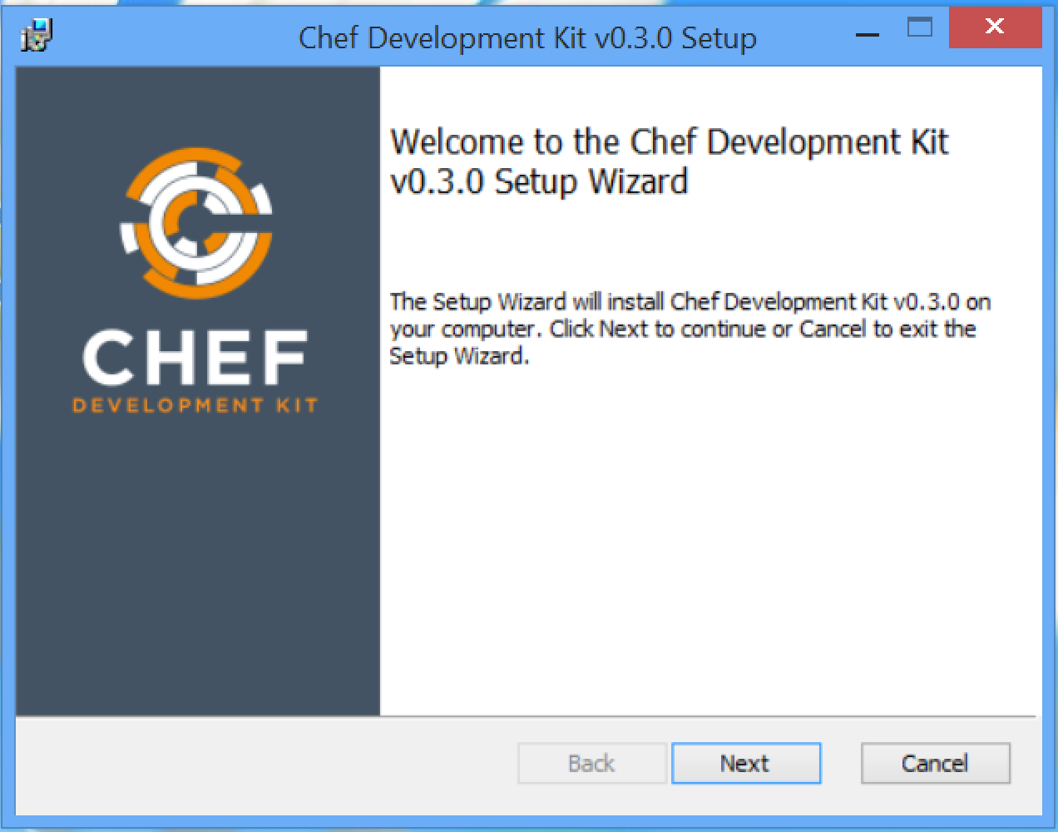

Slide 197
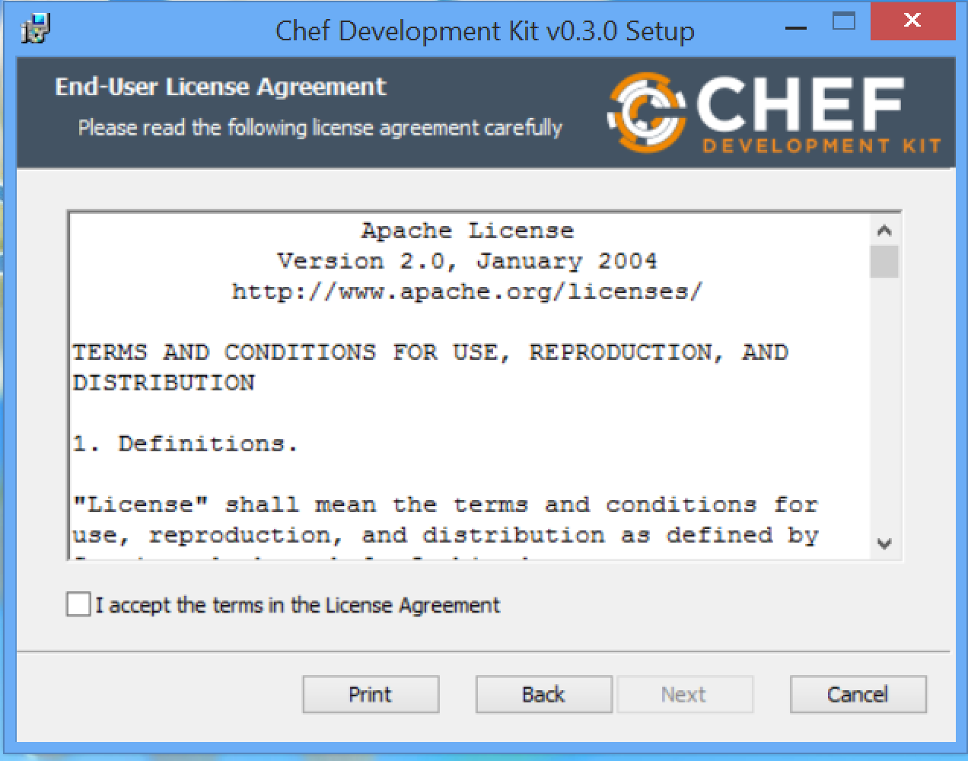

Slide 198
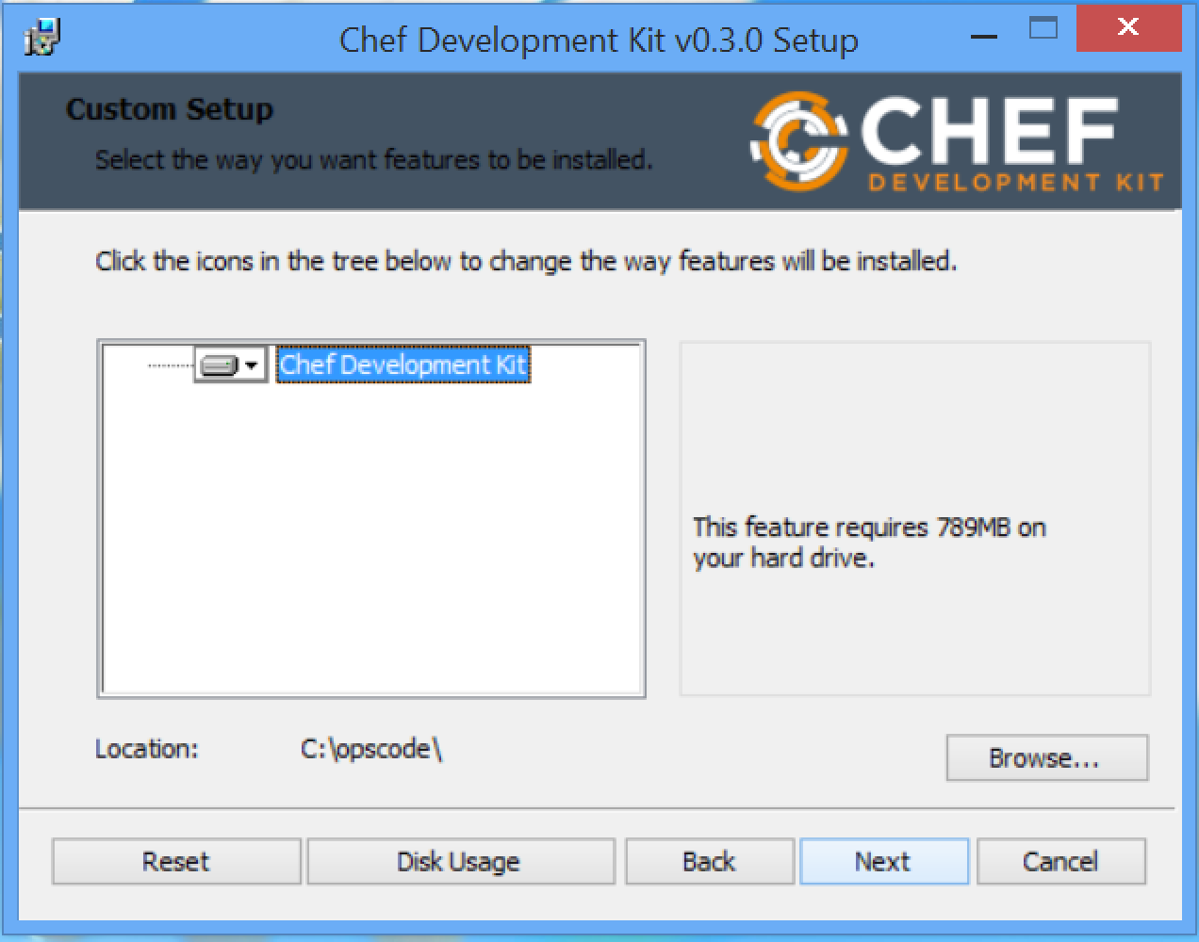

Slide 199
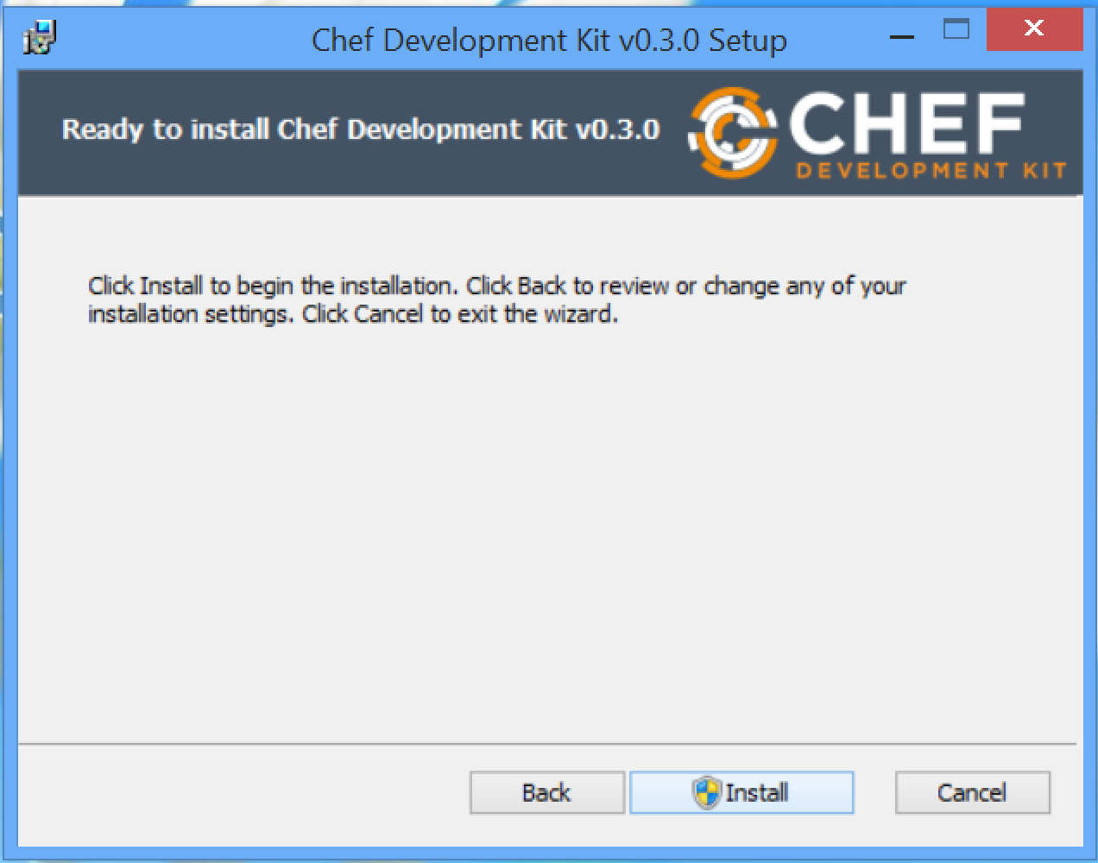

Slide 200
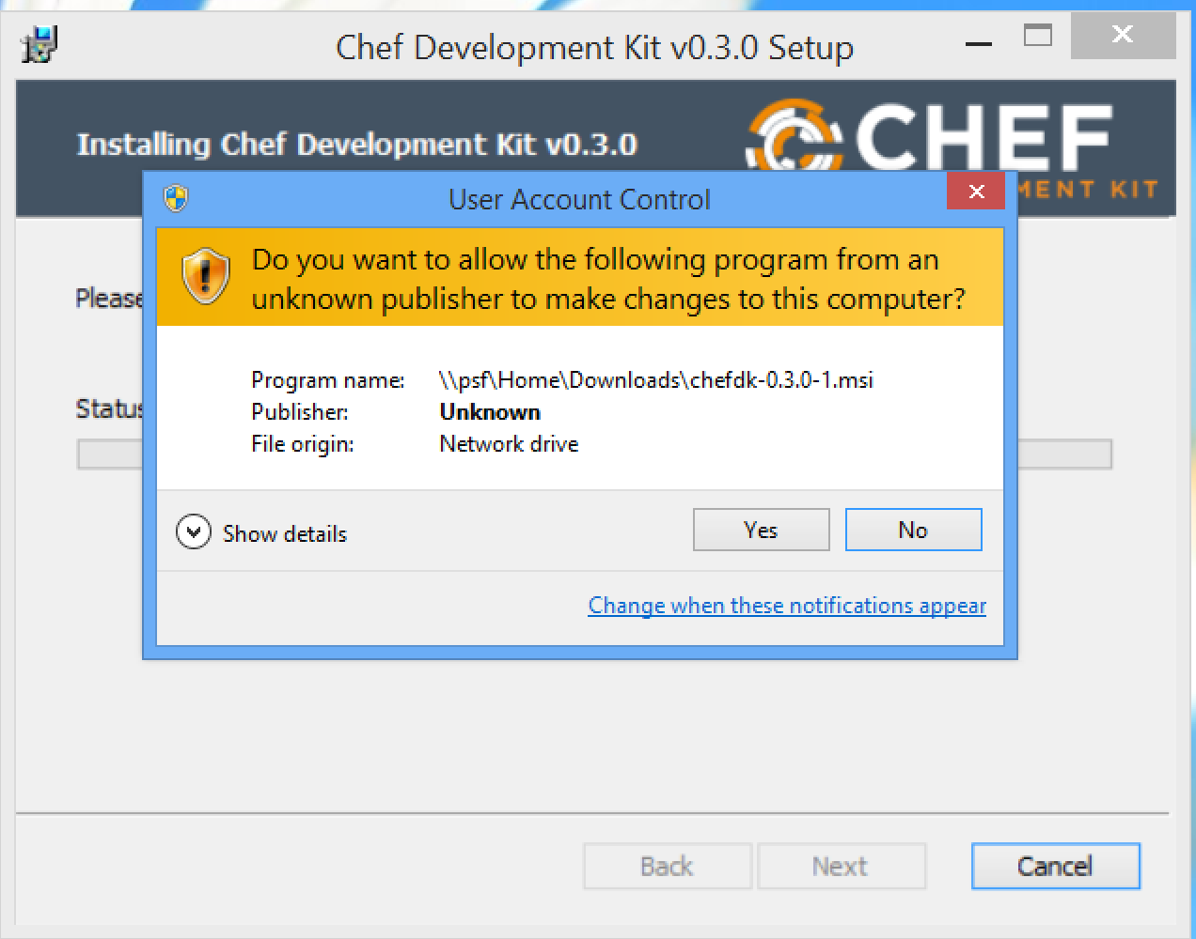

Slide 201
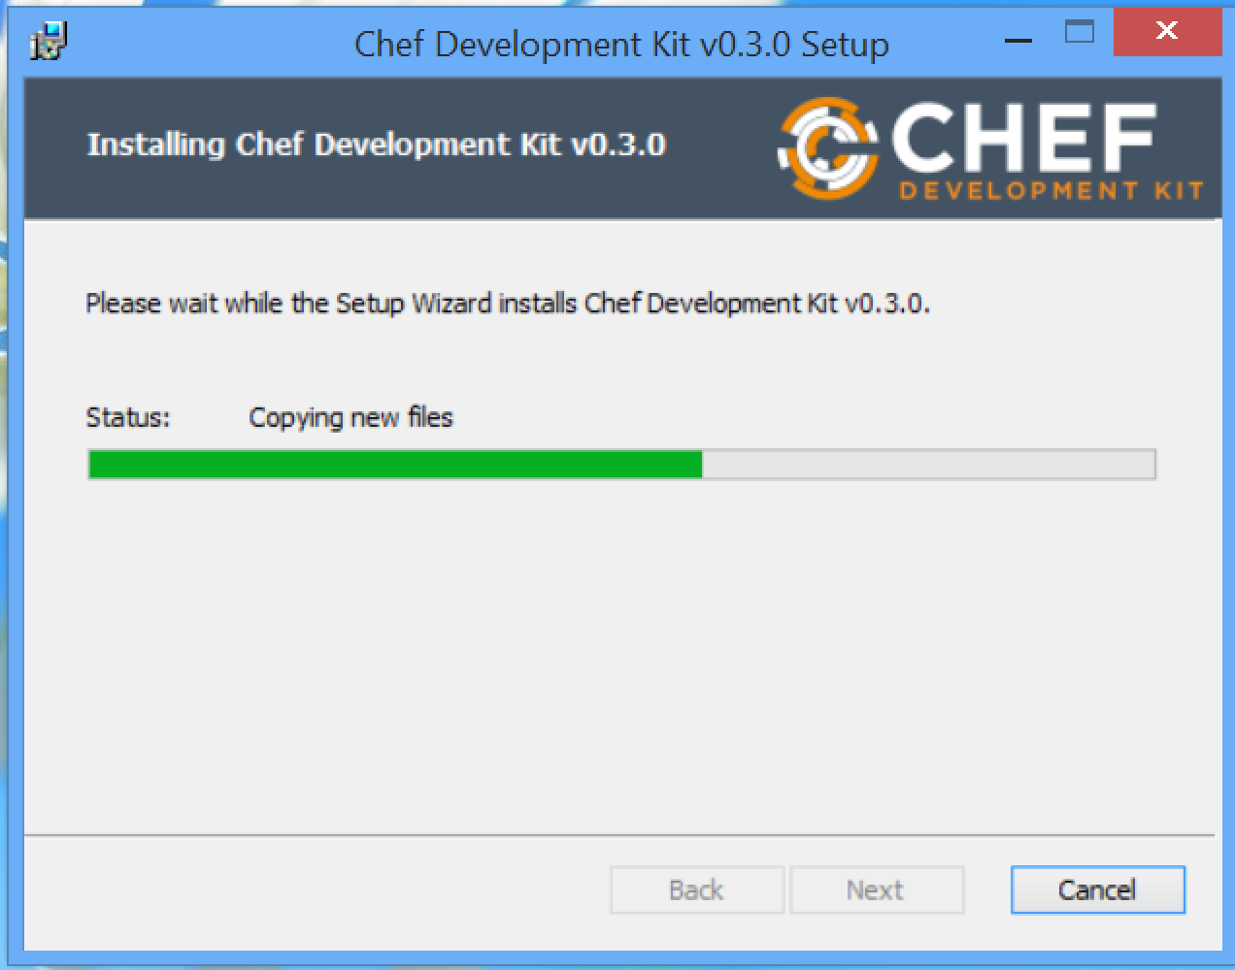

Slide 202
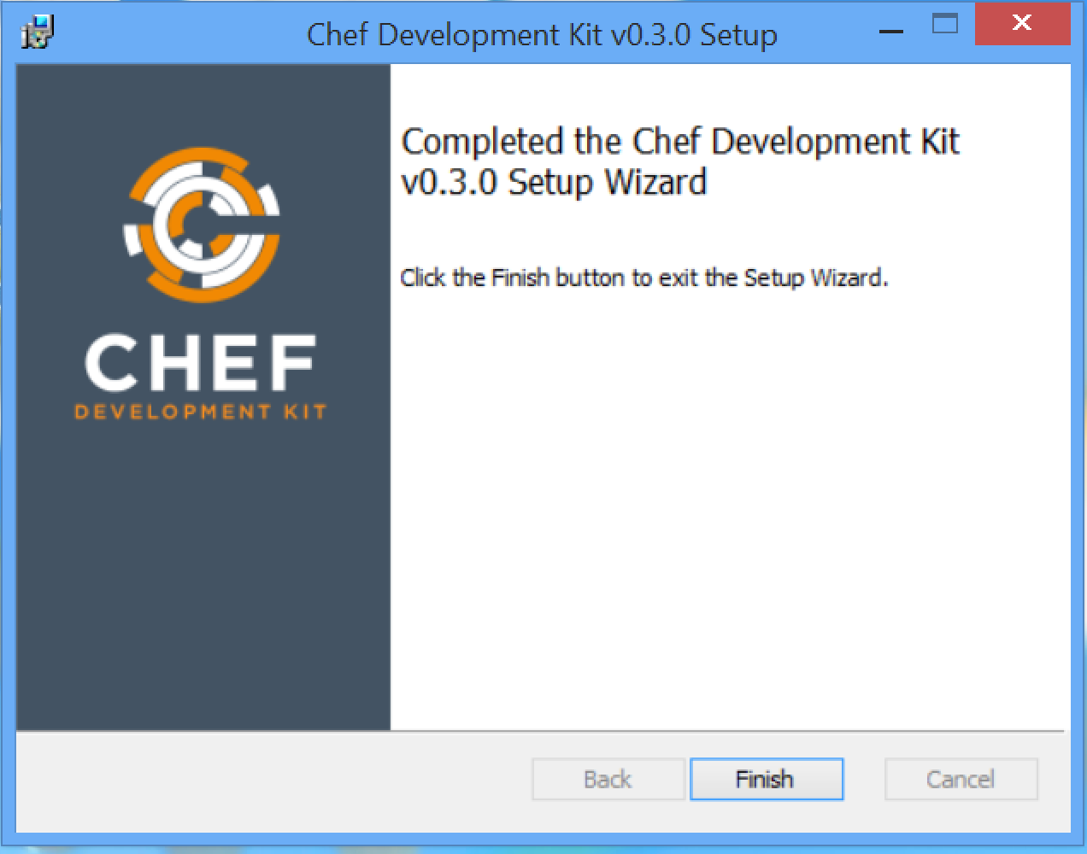

Slide 203
Run All These Commands
PS > chef --version
PS > chef-client --version
PS > knife --version
PS > ohai --version
PS > berks --version
PS > kitchen --version
PS > foodcritic --version
PS > rubocop --version

Slide 204
git
Git is a distributed revision control system with an emphasis on speed, data integrity, and support for distributed, non-linear workflows. Git was initially designed and developed by Linus Torvalds for Linux kernel development in 2005, and has since become the most widely adopted version control system for software development.
http://git-scm.com/downloads

Slide 205
Sublime Text
Sublime Text is a sophisticated text editor for code, markup and prose.
You'll love the slick user interface, extraordinary features and amazing performance.
http://www.sublimetext.com

Slide 206
ATOM Editor
At GitHub, we're building the text editor we've always wanted. A tool you can customize to do anything, but also use productively on the first day without ever touching a config file. Atom is modern, approachable, and hackable to the core. We can't wait to see what you build with it.
https://atom.io

Slide 207
Further Resources

Slide 208
http://bit.ly/chefconf2015
The slides from this workshop and all the workshops from ChefConf 2015

Slide 209
http://bit.ly/cheftraining
The training material for Chef Fundamentals and Extending Chef classes.

Slide 210
http://learnchef.com

Slide 211
http://docs.chef.io

Slide 212
youtube.com/user/getchef

Slide 213
youtube.com/user/getchef

Slide 214
irc.freenode.net#chef
Meetings every two weeks

Slide 215
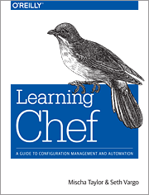
Learning Chef
A Guide to Configuration Management and Automation

Slide 216
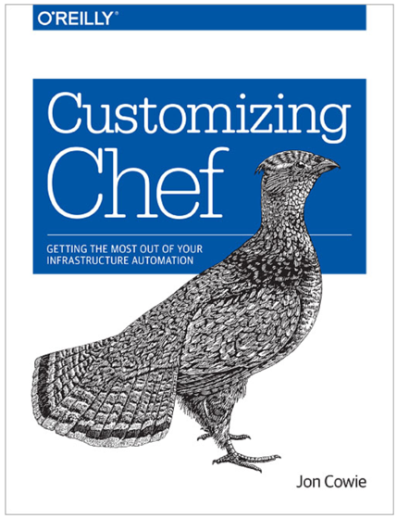
Customizing Chef
Getting the Most Out of Your Infrastructure Automation

